Slide 1
Computational Neuroscience: Introduction and Neuronal Models
Heath Robinson, Ph.D
CWRU Undergraduate Neuroscience

Slide 2
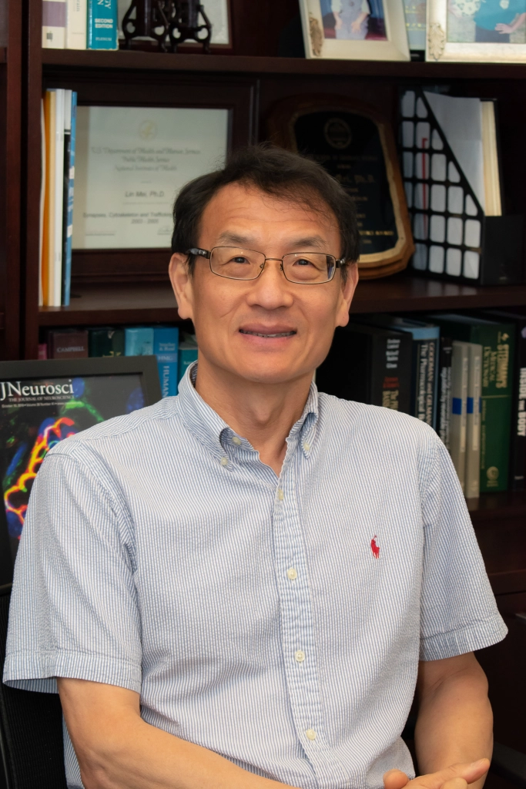



Who I am:
Postdoctoral fellow at Cornell in the labs of Drs. Azahara Oliva and Antonio Fernandez-Ruiz (braincomputations.org)
Did my PhD under Lin Mei MD,PhD at CWRU Neuroscience Department
Currently using large-scale electrophysiology recordings in freely moving animals, using closed-loop optogenetics to understand the physiology of memory consolidation in the cortex
I love electrophysiology and hate how it is normally taught, so here I am!

Slide 3
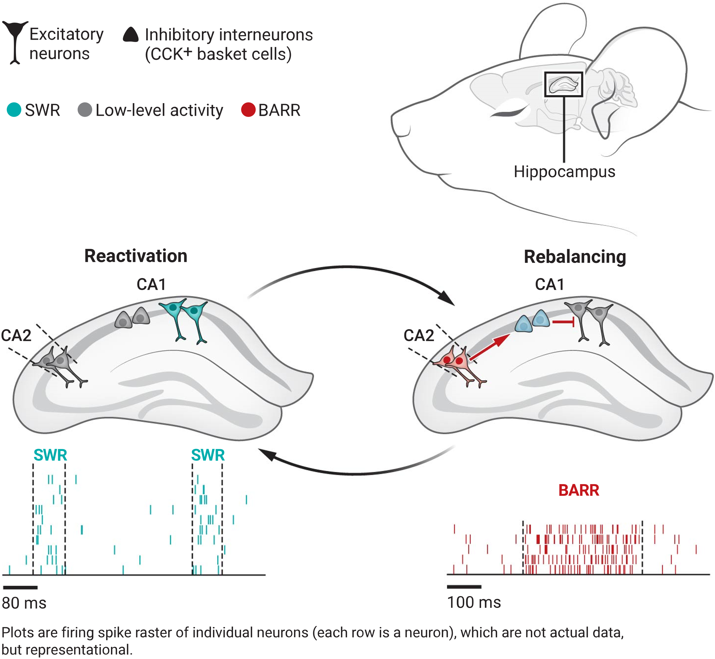
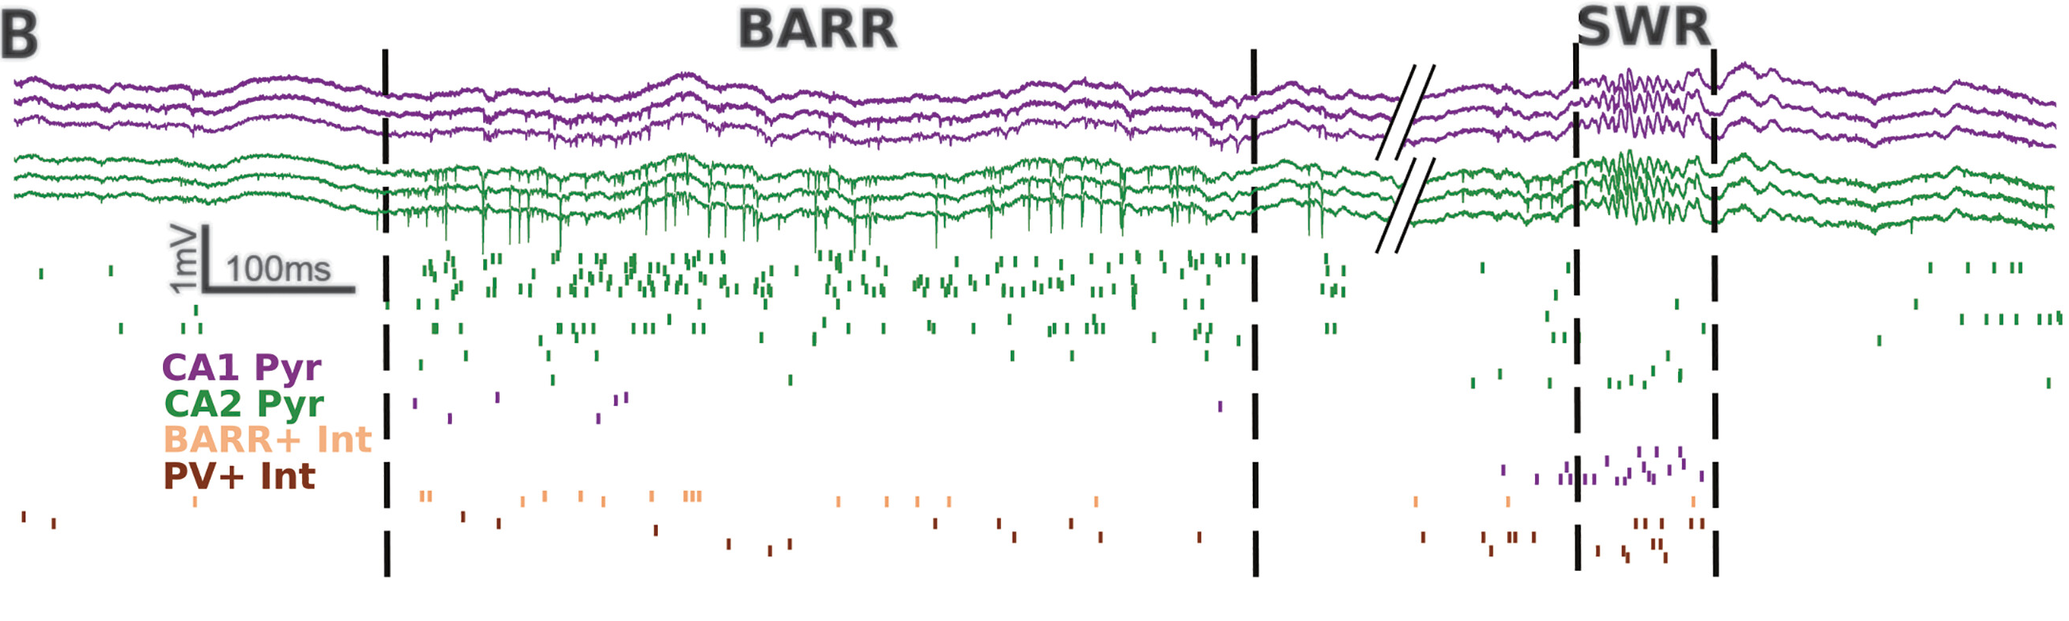
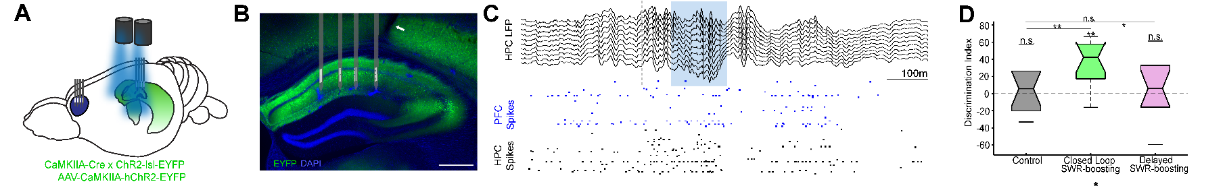
I am currently studying:
Karaba, Robinson et al. Science 2024
Mou and Ji. Science 2024

Slide 4
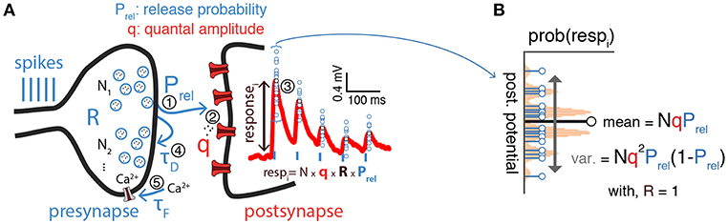
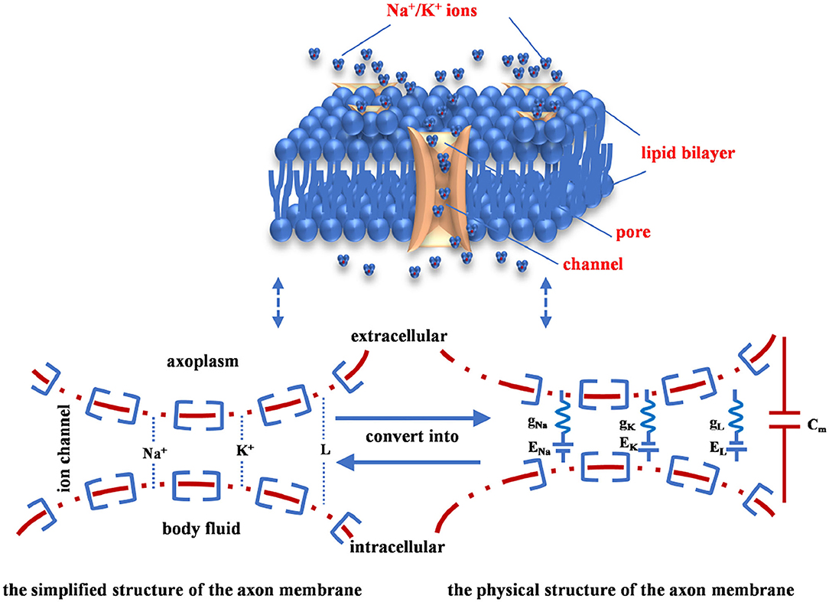
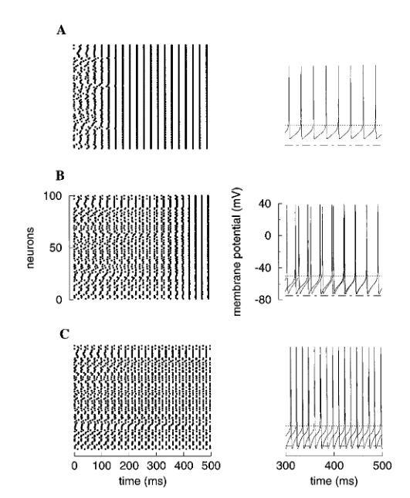
Modelling at different levels of neuroscience
Synapse
Individual Cell
Bykowska et al. Frontiers in Synaptic Neuroscience 2019
Population of neurons
Fang, Duan, Wang Frontiers in Neuroscience 2021
Wang and Buzsaki The Journal of Neuroscience 1996

Slide 5
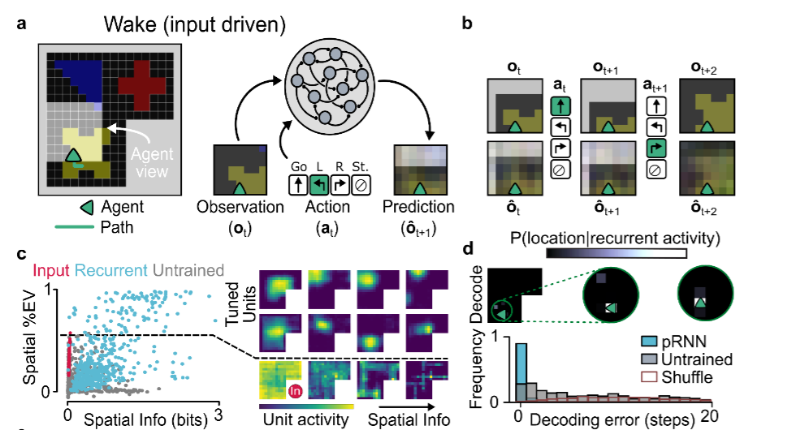

Modeling at different levels of neuroscience: Outside-in modelling (modeling findings to understand experimental findings)
Place Cells emerge in RNN as an agent exploring an environment with sensory input
Levenstein et al. bioRxiv 2024

Slide 6
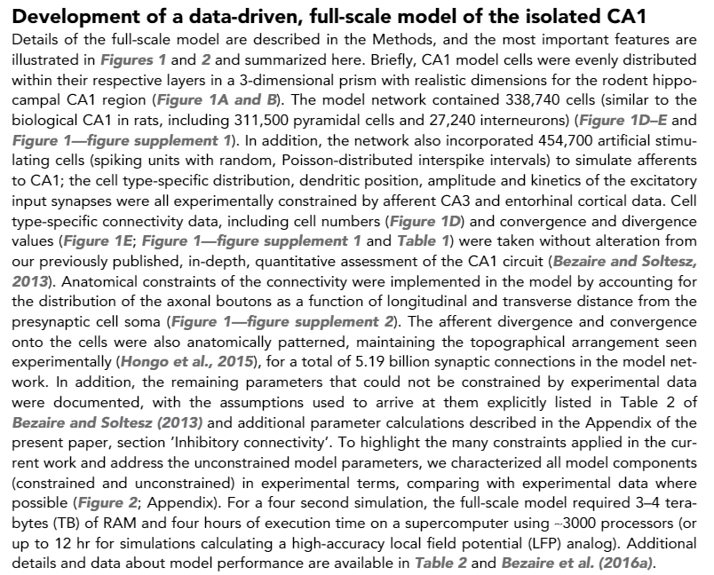
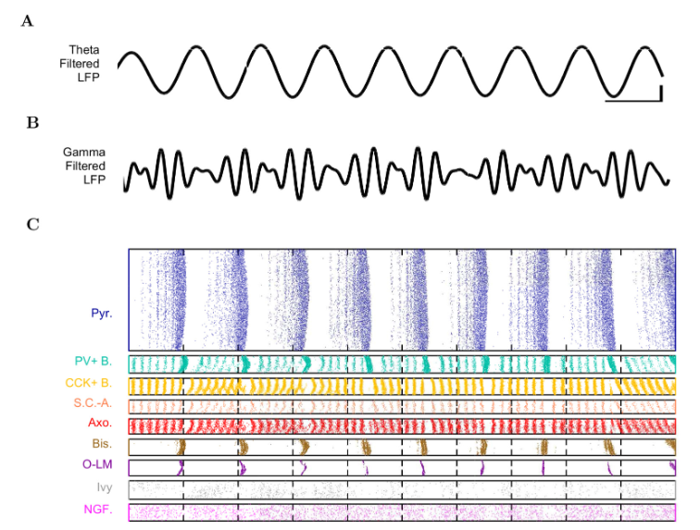
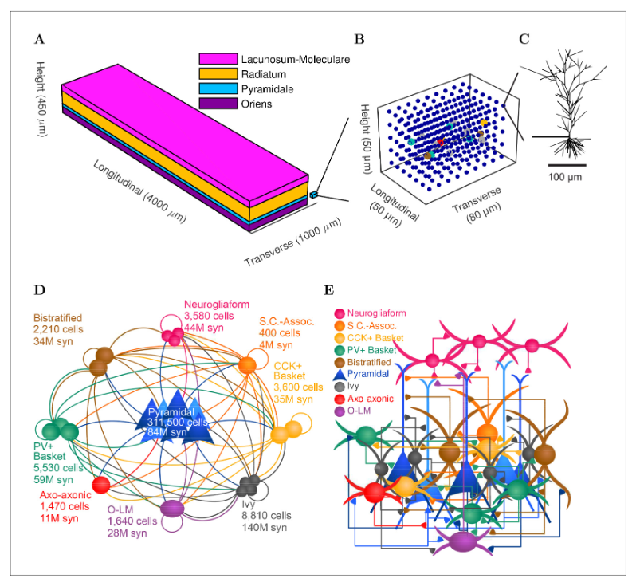
The MOST important question is your scientific hypothesis
What determines your use of a model is the question you are asking and at what level
Identify the level your question is at, then identify the ideal model
You cannot have it all – models at full scale are still not feasible
Bezaire et al. eLife 2016

Slide 7
Modelling at different levels of neuroscience
Synapse
Individual Cell
Bykowska et al. Frontiers in Synaptic Neuroscience 2019
Population of neurons
Fang, Duan, Wang Frontiers in Neuroscience 2021
Wang and Buzsaki The Journal of Neuroscience 1996

Slide 8
So, what is our scientific question?
To gain an understanding of single compartment and approximated models to understand:
Electrophysiology of a single neuron (Hodgkin-Huxley model)
Neural network understanding of brain oscillations (Leaky Integrate and Fire model, PING model)
In this lecture and Wednesday’s lab:
Spoiler 1 – We will see the complexity of a Hodgkin-Huxley model for gaining a mechanistic understanding of how different ions contribute to AP
Spoiler 2 – We will see how Leaky Integrate and Fire models or single-ohmic models are better at network modeling
Spoiler 3 – Use PING model to observe how networks of inhibitory and excitatory neurons lead to oscillations that we observe in the brain (Outside-In Modelling)

Slide 9
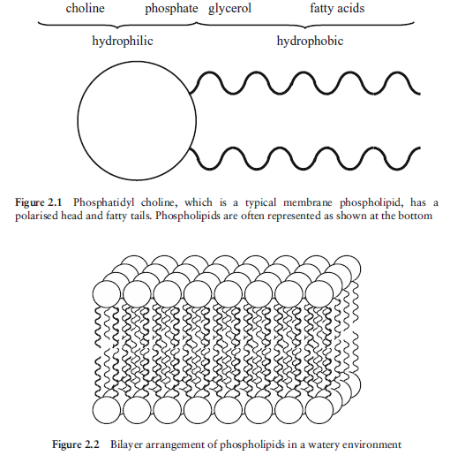
A quick guide to excitable membranes and action potentials – lipid membranes
Forms spontaneously a bilayer in water
Impermeable to “non-lipid” things – such as water molecules
GREAT for not allowing ions in….

Slide 10
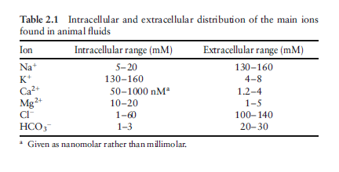
A quick guide to excitable membranes and action potentials – ion distribution
Take a moment and look at the disparity of ions
No matter which you choose you see there is a concentration barrier
We can thank are hard working lipid membrane for this!
This is showing the chemical gradient of ions
But ions also have a charge

Slide 11
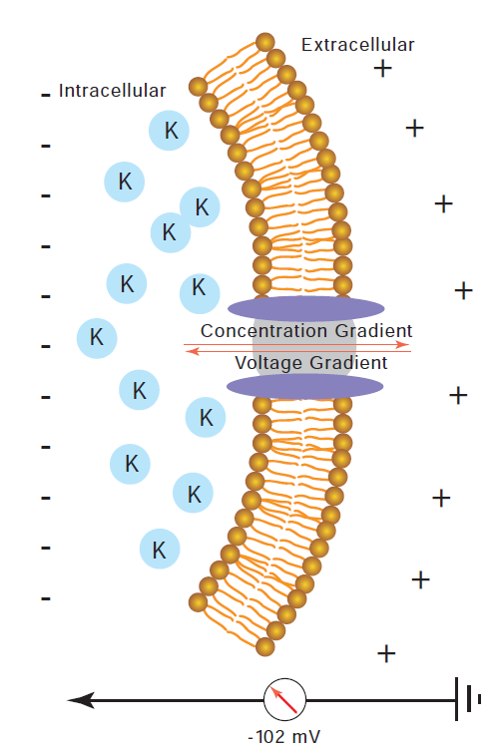
A quick guide to excitable membranes and action potentials – ion distribution
But ions also have a charge
If you set up a chemical gradient of ions, you will inherit their charge
This is what Neuroscience means when it says there is an electrochemical gradient
It is important to remember that both the charge disparity of the membrane and natural gradient of concentration both will determine flow of these ions (the electro-chemical aspects are linked)

Slide 12
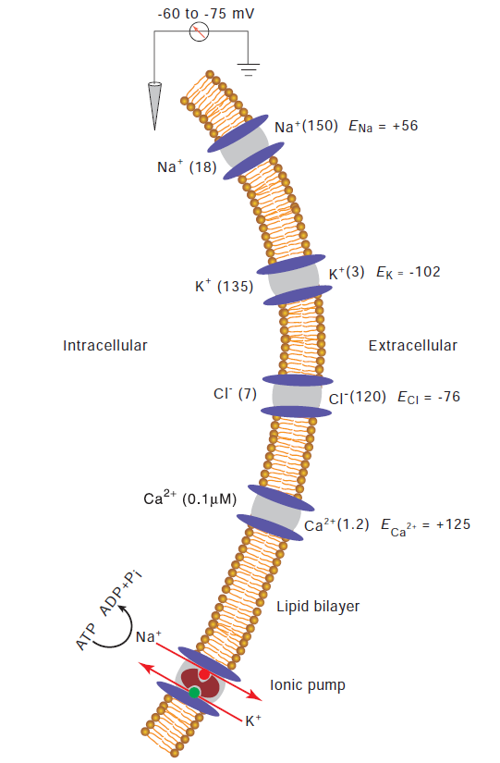
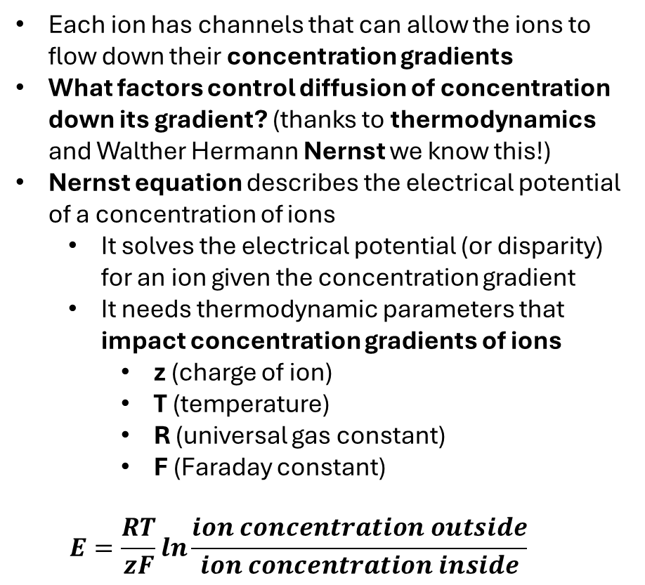
A quick guide to excitable membranes and action potentials – ion distribution all together
Each ion has channels that can allow the ions to flow down their concentration gradients
What factors control diffusion of concentration down its gradient? (thanks to thermodynamics and Walther Hermann Nernst we know this!)
Nernst equation describes the electrical potential of a concentration of ions
It solves the electrical potential (or disparity) for an ion given the concentration gradient
It needs thermodynamic parameters that impact concentration gradients of ions
z (charge of ion)
T (temperature)
R (universal gas constant)
F (Faraday constant)
$$E=\frac{RT}{zF}ln\frac{ion concentration outside}{ion concentration inside}$$

Slide 13
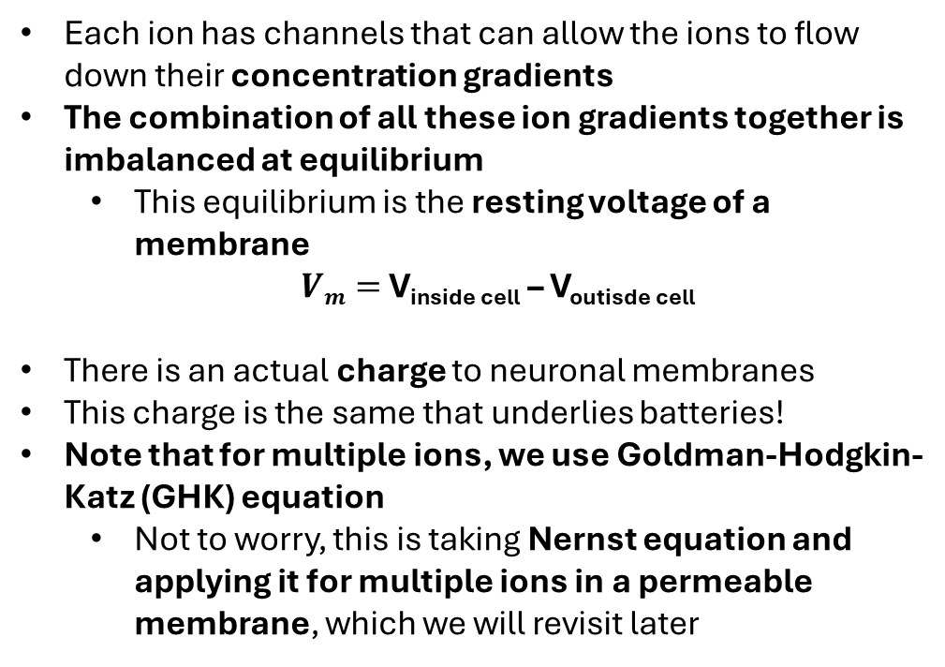
A quick guide to excitable membranes and action potentials – ion distribution all together
Each ion has channels that can allow the ions to flow down their concentration gradients
The combination of all these ion gradients together is imbalanced at equilibrium
This equilibrium is the resting voltage of a membrane
$Vm=$V_{inside cell} – V_{outisde cell}
There is an actual charge to neuronal membranes
This charge is the same that underlies batteries!
Note that for multiple ions, we use Goldman-Hodgkin-Katz (GHK) equation
Not to worry, this is taking Nernst equation and applying it for multiple ions in a permeable membrane, which we will revisit later

Slide 14
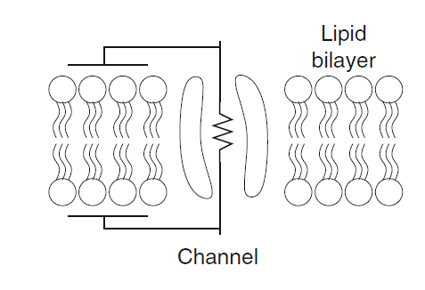
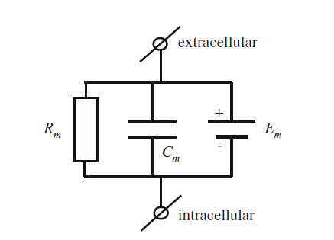

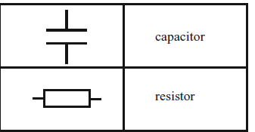
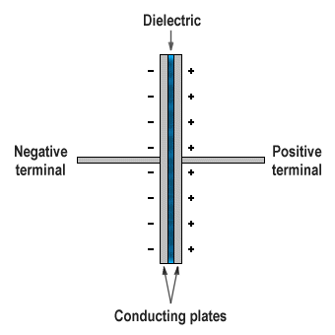
A quick guide to excitable membranes and action potentials – electrical engineering view
Due to the electrical nature of neuronal membranes, they are often diagramed as an electrical circuit
This helps us understand different parts of electrical charges
A resistor a device that resists electrical flow
A capacitor is electoral device that stores charges by the natural thermodynamic law that if you have charge disparity the opposing charged ions will align as close to each other as possible
Capacitor

Slide 15
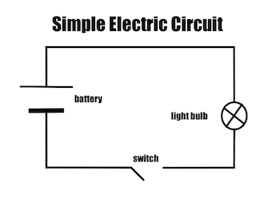
A quick guide to excitable membranes and action potentials – electrical engineering view
The membrane is a natural resistor and capacitance naturally occurs
Resistor + capacitor + battery (our electrochemical gradient) = simple circuit with a battery
What is the “Switch” though in our membrane?

Slide 16
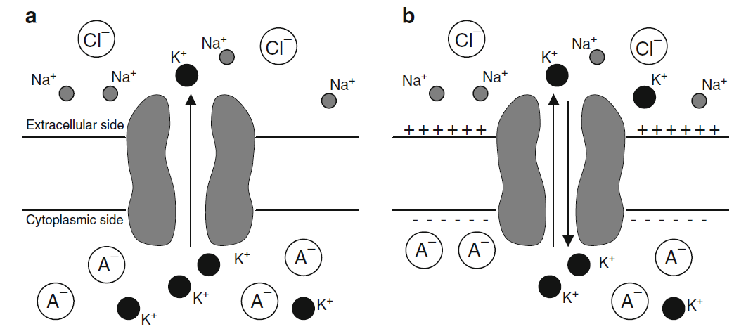
A quick guide to excitable membranes and action potentials – Voltage-gated permeable ion channels
The switch is permeable ion channels
When open they allow ions to flow down their electro-chemical gradient
These aren’t just permeable channels; they are triggered by voltage changes in the membrane
Look at the capacitance that is naturally occurring at this membrane!

Slide 17
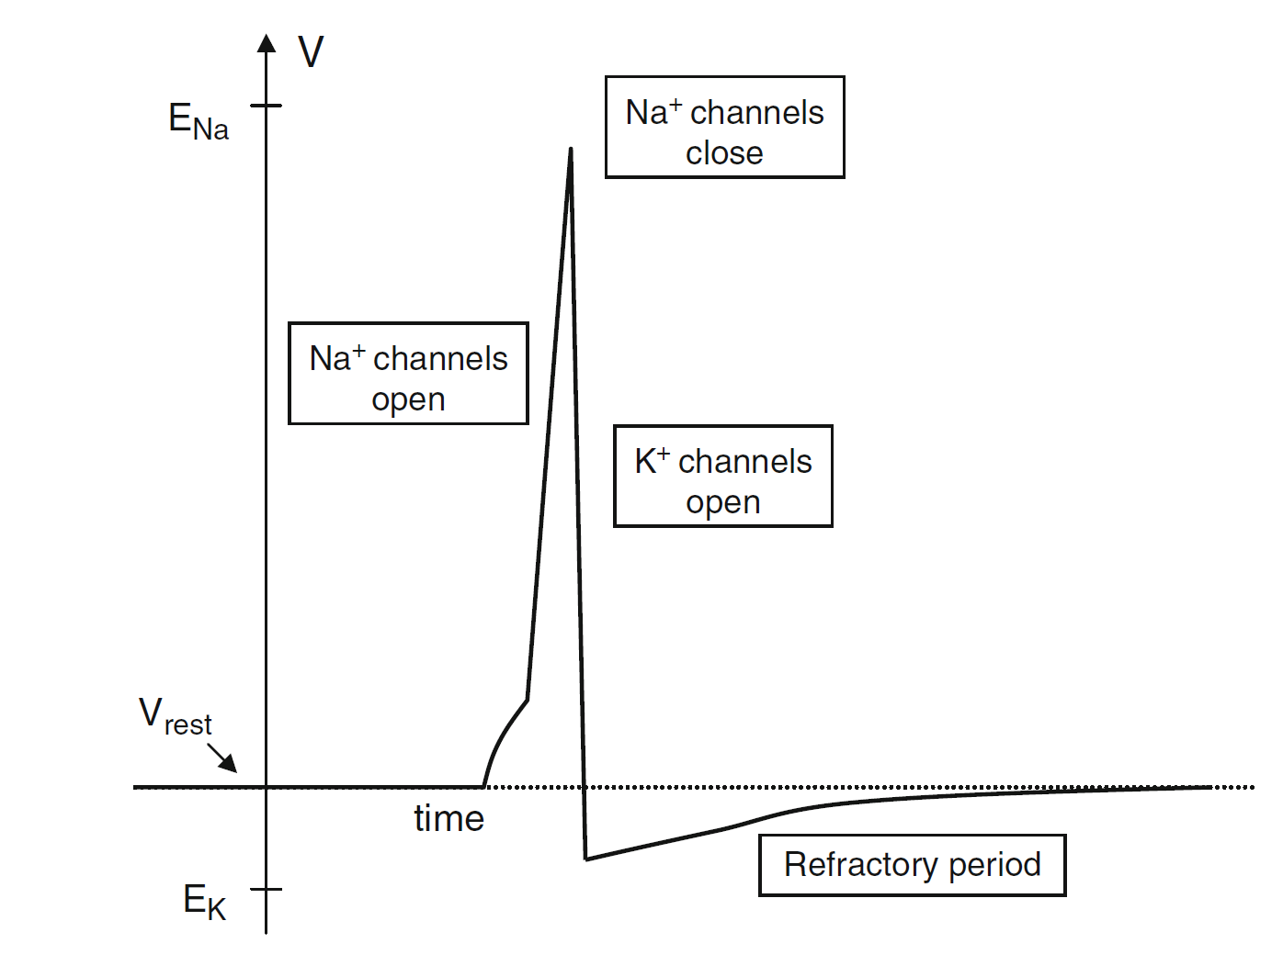
A quick guide to excitable membranes and action potentials – Action Potentials
As calcium is increasing, neurotransmitters are being released from presynaptic neuron
Neurotransmitters bind to postsynapstic neuron’s receptors and start depolarizing the postsynaptic neuron
Enough depolarization activates depolarization of voltage-gated Na+ channels that allows Na+ to go down its concentration gradient
Na+ going down its gradient (flowing into the neuron) is also a positive ion that increases the membrane further
The large voltage increase activates K+ channels that allow K+ to flow down its gradient (flowing out of the neuron) and repolarize the neuron
The K+ channels remain open past the neurons resting membrane potential known as the refractory period
Depolarization = away from resting potential
Repolarization = towards resting potential

Slide 18
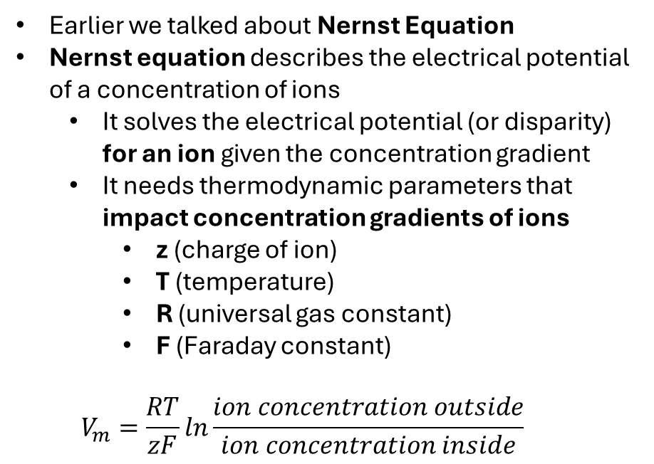
Going from Nernst to GSK equations – a full equation including all ions
Earlier we talked about Nernst Equation
Nernst equation describes the electrical potential of a concentration of ions
It solves the electrical potential (or disparity) for an ion given the concentration gradient
It needs thermodynamic parameters that impact concentration gradients of ions
z (charge of ion)
T (temperature)
R (universal gas constant)
F (Faraday constant)
$$V_{m}=\frac{RT}{zF}ln\frac{ion concentration outside}{ion concentration inside}$$
There is an issue though!
We have multiple ions!

Slide 19
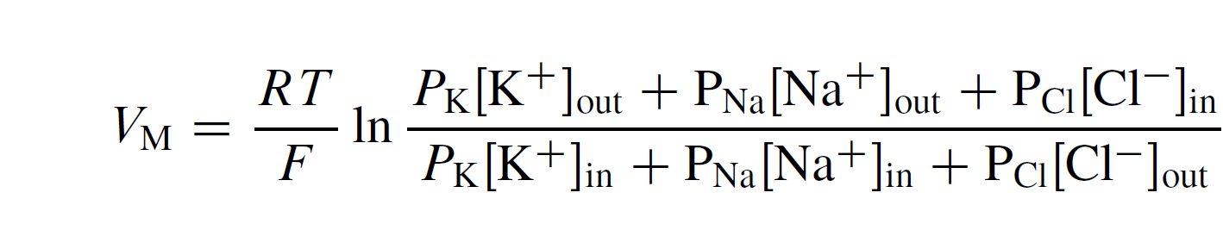
Going from Nernst to GSK equations – a full equation including all ions
For multiple ions, we use Goldman-Hodgkin-Katz (GHK) equation
GHK is Nernst equation applied for multiple ions in a permeable membrane
We will add permeability now that we know that voltage-gated ion channels are permeable to certain ions.
GHK:
Note: P_{ion} is the permeability at any time for a given ion (depending on the state of the voltage gated ion channels
Now we have an equation that gives us the terms of Vm since it is the electrical potential across the whole membrane
Z is also gone because we assign charge differently for each ion (it is within the calculation for Permeability (P_{ion}))

Slide 20
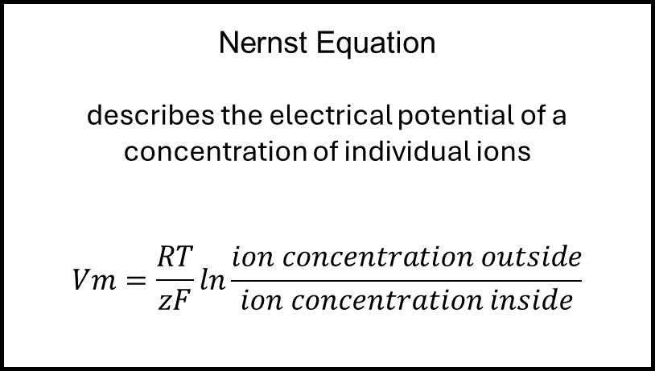
Quick Summary
Science
Ions carry a charge + concentration
Lipid Blocks ion movement
Neuronal membranes have ion disparity across the membrane (i.e. voltage)
Action Potentials change permeability to sodium then potassium via voltage gated ion permeable channels
Modelling
Nernst Equation
describes the electrical potential of a concentration of individual ions
$$Vm=\frac{RT}{zF}ln\frac{ion concentration outside}{ion concentration inside}$$
GHK Equation
GHK is Nernst equation applied for multiple ions in a permeable membrane

Slide 21
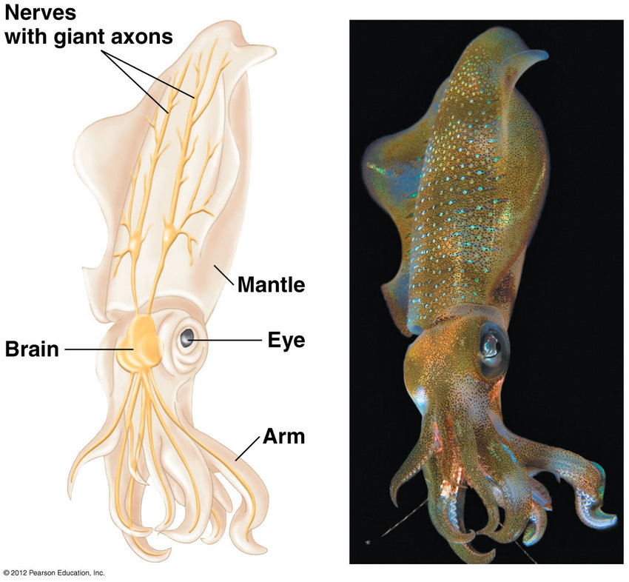
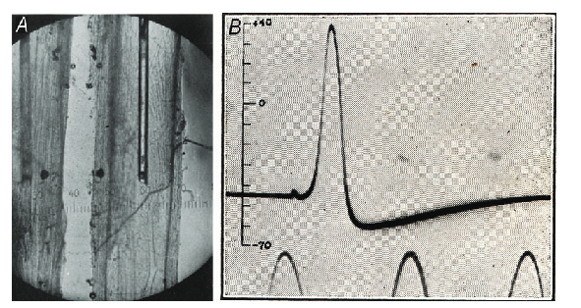

Where are we in time…
1939 – Hodgkin and Huxley publish first recorded Action Potential in Nature. Hodgkin noted “…the membrane potential at the peak of the nerve impulse reversed by 40 mV instead of falling to zero as assumed in the classical theory”
Hitler invades Poland, escalating into WW2.
1937 - Hodgkin works with KS Cole and HJ Curtis at Wood Hole Marine Biological Lab in Massachusetts. Hodgkin introduced to giant nerve fiber of the squid

Slide 22
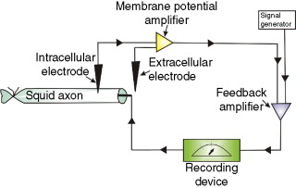
Where are we in time…
1946– John Eccles used a voltage clamp and found that action potential overshoot was NOT due to sodium. Hodgkin and Huxley could not perform voltage clamp at first returning from the war due to damaged equipment during the war.
1949– Hodgkin and Huxley now record voltage clamp and gain insight into gating variables via fitting sodium and potassium channel dynamics
“At first, the response of a nerve to different electrical stimuli is too complicated and varied to be explained by these relatively simple conclusions. Partly for this reason, Huxley and I spent a long time developing what are sometimes known as the Hodgkin-Huxley equations, which are given in outline below. In using the equations it should be emphasized that there are no arbitrary constants, as the voltage-clamp results were used to supply the numerical data required.”

Slide 23
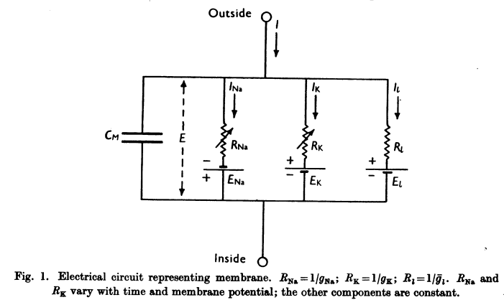
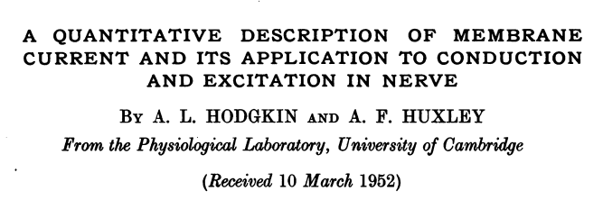
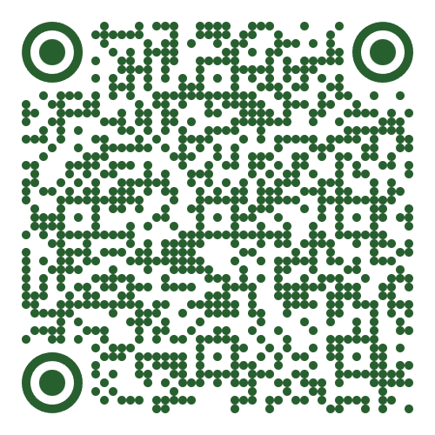
Hodgkin-Huxley equation contextualized
GSK equation has allowed for finding the resting membrane potential (Vm)
Hodgkin-Huxley equation is now going to try and look at how these voltage potentials change during an action potential
The GSK equation has an issue – it assumes no changes in permeability, which you know changes during an action potential!

Slide 24
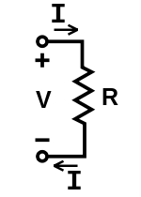
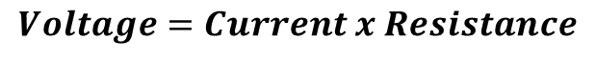
Hodgkin-Huxley equation
We are hoping to find out about the change of voltage over time during an action potential
If we are talking about changes in voltage, we are really talking about ions moving = current
Both Nernst and GHK equations set the current = 0
This isn’t a mistake, but the goal of these equation was to find the total electrical potential across the membrane at rest
These equations provided the reversal potential of each ion, something we now need
Ohms Law is a simple equation on which we start to build, as it is ideal situations when current ≠0
We can use Ohms law to find I (current) for each part of our circuit in hopes of finding overall current changes during an action potential:
Current of a simple membrane
Current for each ion
1.
2a.
2b.
2c.
Ohm’s Law
$$Voltage=Current x Resistance$$

Slide 25
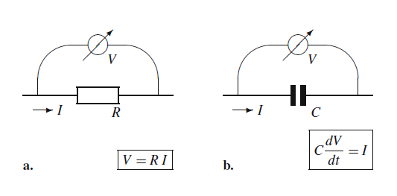
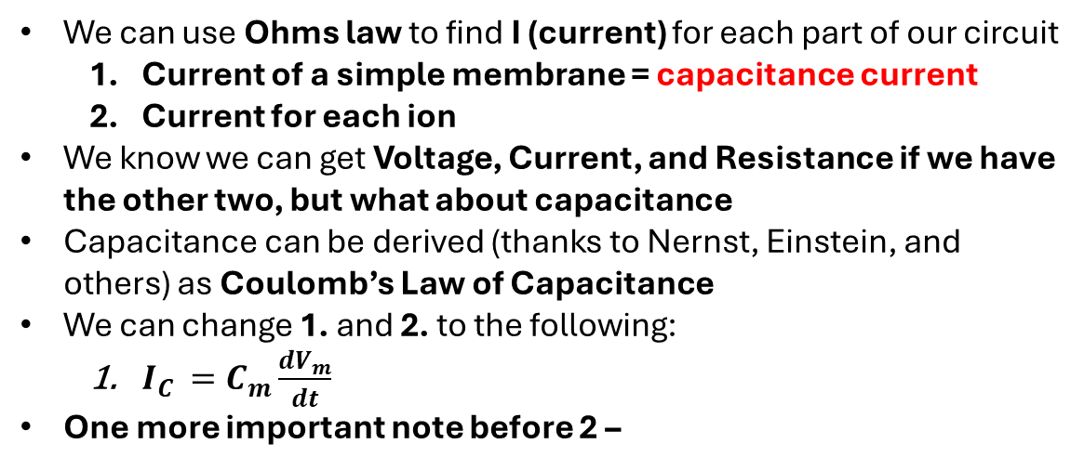
Hodgkin-Huxley equation – Coulomb’s Law of Capacitance
1.
We can use Ohms law to find I (current) for each part of our circuit
Current of a simple membrane = capacitance current
Current for each ion
We know we can get Voltage, Current, and Resistance if we have the other two, but what about capacitance
Capacitance can be derived (thanks to Nernst, Einstein, and others) as Coulomb’s Law of Capacitance
We can change 1. and 2. to the following:
$I_{C }=C_{m}\frac{dV_{m}}{dt}$
One more important note before 2 –
2a.
2b.
2c.
Ohm’s Law
Coulomb’s Law

Slide 26
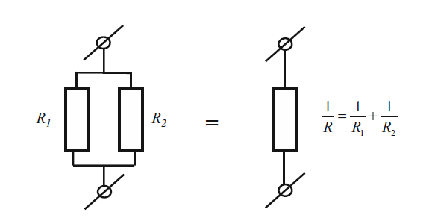
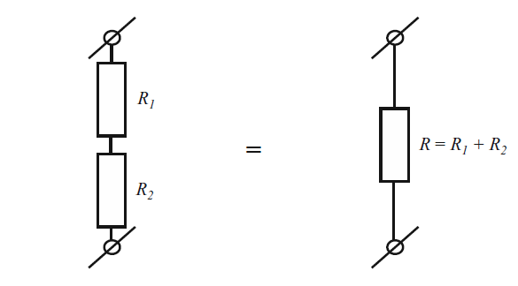
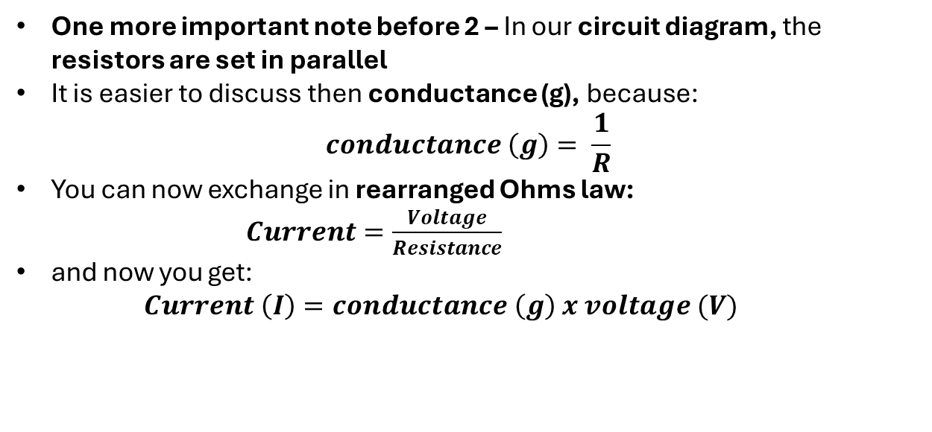
Hodgkin-Huxley equation – Ohms law in resistors in parallel
1.
One more important note before 2 – In our circuit diagram, the resistors are set in parallel
It is easier to discuss then conductance (g), because:
$$conductance \left(g\right)= \frac{1}{R}$$
You can now exchange in rearranged Ohms law:
$Current=\frac{Voltage}{Resistance}$
and now you get:
$$Current \left(I\right)=conductance \left(g\right) x voltage (V)$$
2a.
2b.
2c.
Resistors in series
Resistors in parallel

Slide 27
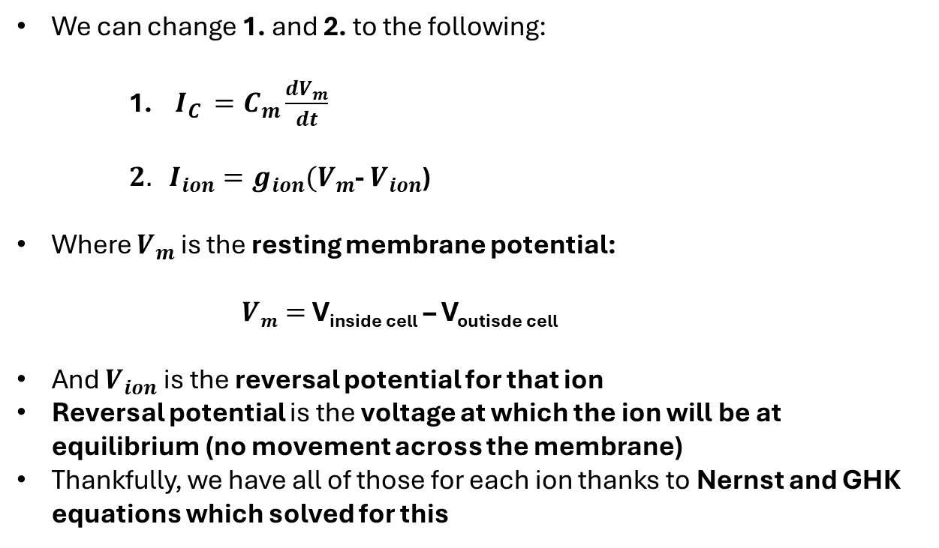
Hodgkin-Huxley equation
We can change 1. and 2. to the following:
1. $I_{C }=C_{m}\frac{dV_{m}}{dt}$
$2. I_{ion}=g_{ion}(V_{m}$- $V_{ion}$)
Where $V_{m}$ is the resting membrane potential:
$Vm=$V_{inside cell} – V_{outisde cell}
And $V_{ion}$ is the reversal potential for that ion
Reversal potential is the voltage at which the ion will be at equilibrium (no movement across the membrane)
Thankfully, we have all of those for each ion thanks to Nernst and GHK equations which solved for this
1.
Coulomb’s law
Trick to use Ohm’s law with resistors in series
2a.
2b.
2c.

Slide 28
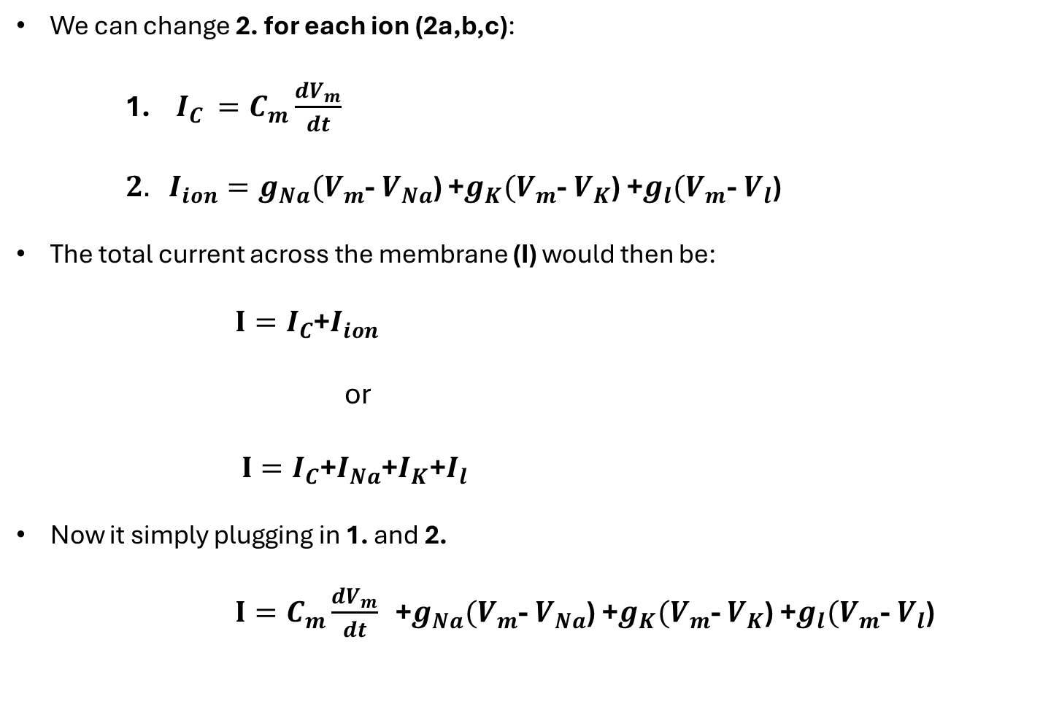
Hodgkin-Huxley equation
We can change 2. for each ion (2a,b,c):
1. $I_{C }=C_{m}\frac{dV_{m}}{dt}$
$2. I_{ion}=g_{Na}(V_{m}$- $V_{Na}$) +$g_{K}(V_{m}$- $V_{K}$) +$g_{l}(V_{m}$- $V_{l}$)
The total current across the membrane (I) would then be:
$I=I_{C}$+$I_{ion}$
or
$I=I_{C}$+$I_{Na}$+$I_{K}\text{+}I_{l}$
Now it simply plugging in 1. and 2.
$I=C_{m}\frac{dV_{m}}{dt}$+$g_{Na}(V_{m}$- $V_{Na}$) +$g_{K}(V_{m}$- $V_{K}$) +$g_{l}(V_{m}$- $V_{l}$)
2a.
2b.
2c.
1.
2a.
2b.
2c.

Slide 29
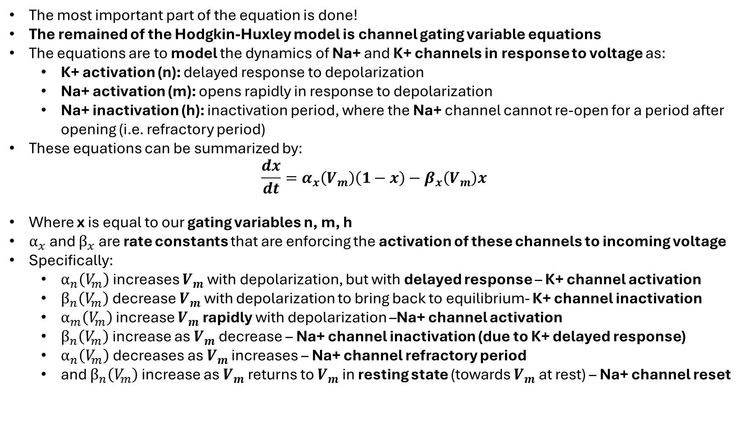
Hodgkin-Huxley equation
The most important part of the equation is done!
The remained of the Hodgkin-Huxley model is channel gating variable equations
The equations are to model the dynamics of Na+ and K+ channels in response to voltage as:
K+ activation (n): delayed response to depolarization
Na+ activation (m): opens rapidly in response to depolarization
Na+ inactivation (h): inactivation period, where the Na+ channel cannot re-open for a period after opening (i.e. refractory period)
These equations can be summarized by:
$$\frac{dx}{dt}=α_{x}\left(V_{m}\right)\left(1−x\right)−β_{x}\left(V_{m}\right)x$$
Where x is equal to our gating variables n, m, h
$α_{x}$ and $β_{x}$ are rate constants that are enforcing the activation of these channels to incoming voltage
Specifically:
$α_{n}\left(V_{m}\right)$ increases $V_{m}$with depolarization, but with delayed response – K+ channel activation
$β_{n}\left(V_{m}\right)$ decrease $V_{m}$ with depolarization to bring back to equilibrium- K+ channel inactivation
$α_{m}\left(V_{m}\right)$ increase $V_{m}$rapidly with depolarization –Na+ channel activation
$β_{n}\left(V_{m}\right)$ increase as $V_{m}$decrease – Na+ channel inactivation (due to K+ delayed response)
$α_{n}\left(V_{m}\right)$ decreases as $V_{m}$ increases – Na+ channel refractory period
and $β_{n}\left(V_{m}\right)$ increase as $V_{m}$returns to $V_{m}$ in resting state (towards $V_{m}$ at rest) – Na+ channel reset

Slide 30
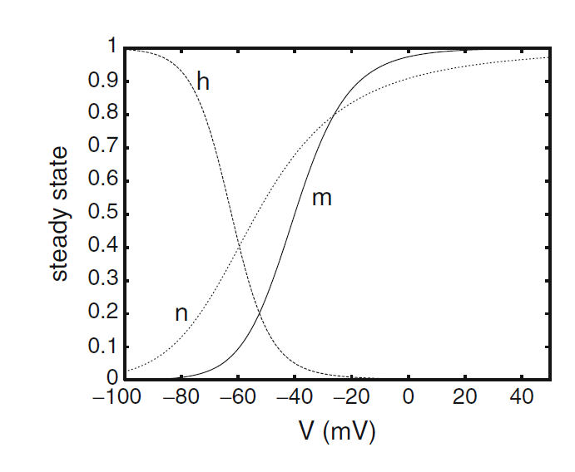
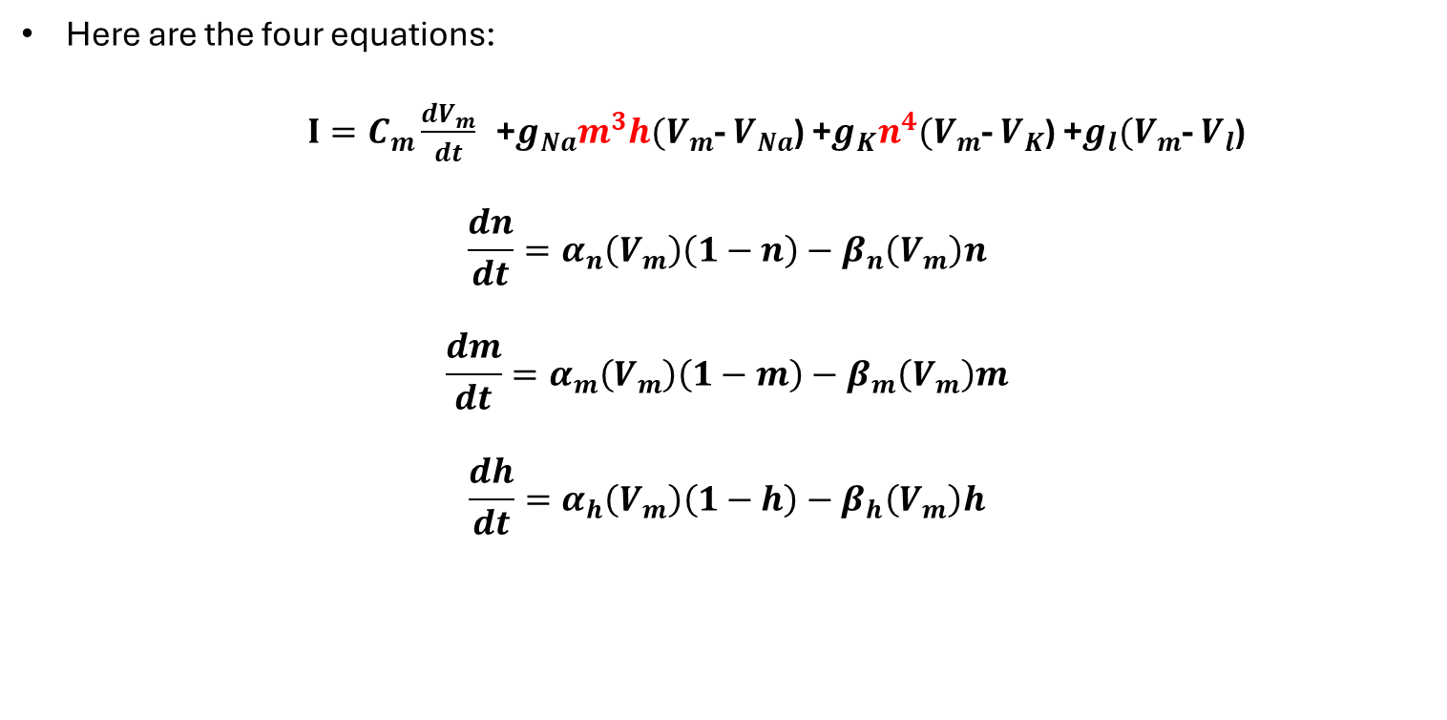
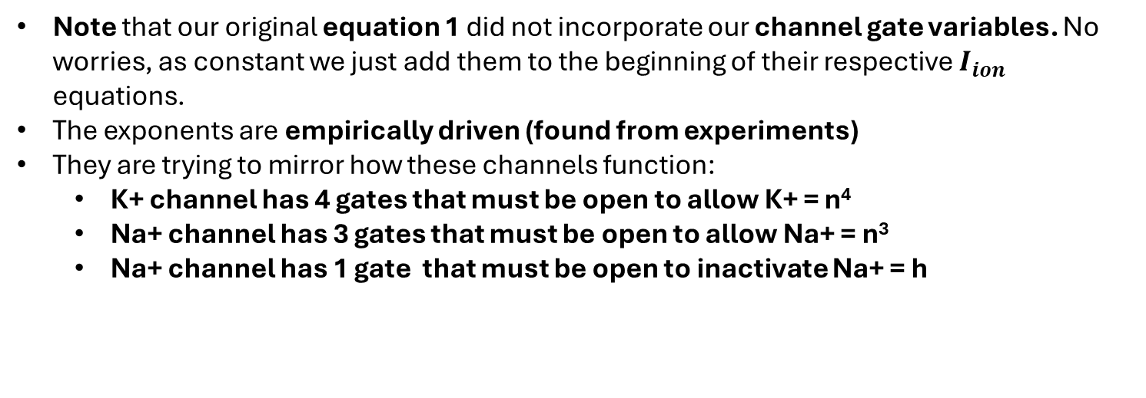
Hodgkin-Huxley equation
Here are the four equations:
$I=C_{m}\frac{dV_{m}}{dt}$+$g_{Na}m^{3}h(V_{m}$- $V_{Na}$) +$g_{K}n^{4}(V_{m}$- $V_{K}$) +$g_{l}(V_{m}$- $V_{l}$)
$$\frac{dn}{dt}=α_{n}\left(V_{m}\right)\left(1−n\right)−β_{n}\left(V_{m}\right)n$$
$$\frac{dm}{dt}=α_{m}\left(V_{m}\right)\left(1−m\right)−β_{m}\left(V_{m}\right)m$$
$$\frac{dh}{dt}=α_{h}\left(V_{m}\right)\left(1−h\right)−β_{h}\left(V_{m}\right)h$$
Note that our original equation 1 did not incorporate our channel gate variables. No worries, as constant we just add them to the beginning of their respective $I_{ion}$ equations.
The exponents are empirically driven (found from experiments)
They are trying to mirror how these channels function:
K+ channel has 4 gates that must be open to allow K+ = n⁴
Na+ channel has 3 gates that must be open to allow Na+ = n³
Na+ channel has 1 gate that must be open to inactivate Na+ = h

Slide 31
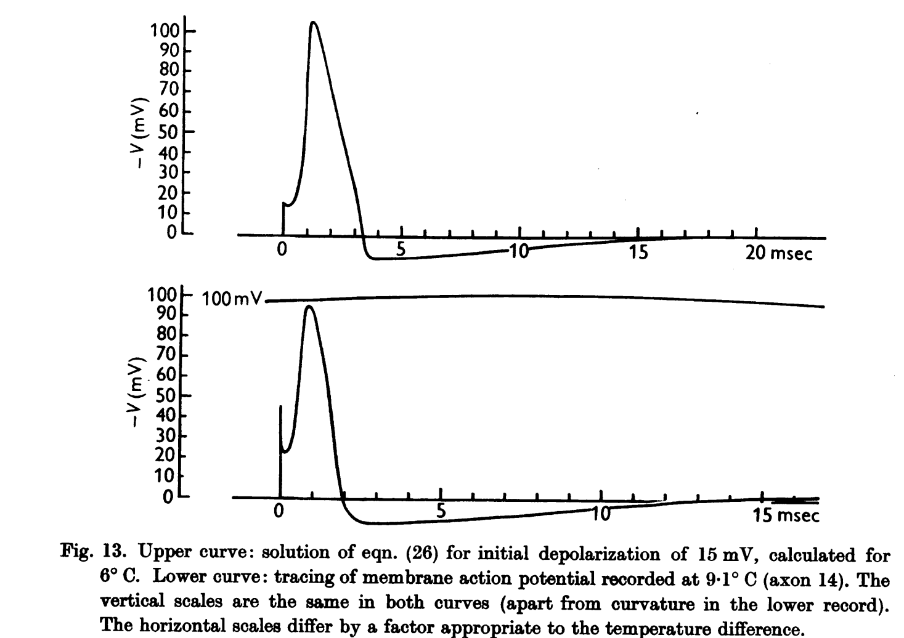
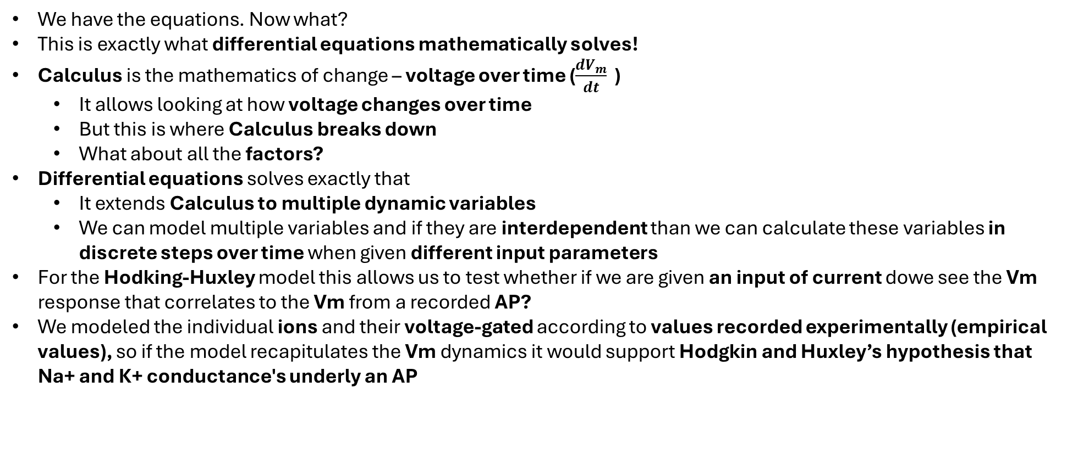
Hodgkin-Huxley equation
We have the equations. Now what?
This is exactly what differential equations mathematically solves!
Calculus is the mathematics of change – voltage over time ($\frac{dV_{m}}{dt}$)
It allows looking at how voltage changes over time
But this is where Calculus breaks down
What about all the factors?
Differential equations solves exactly that
It extends Calculus to multiple dynamic variables
We can model multiple variables and if they are interdependent than we can calculate these variables in discrete steps over time when given different input parameters
For the Hodking-Huxley model this allows us to test whether if we are given an input of current dowe see the Vm response that correlates to the Vm from a recorded AP?
We modeled the individual ions and their voltage-gated according to values recorded experimentally (empirical values), so if the model recapitulates the Vm dynamics it would support Hodgkin and Huxley’s hypothesis that Na+ and K+ conductance's underly an AP

Slide 32
Hodgkin-Huxley equation results

Slide 33
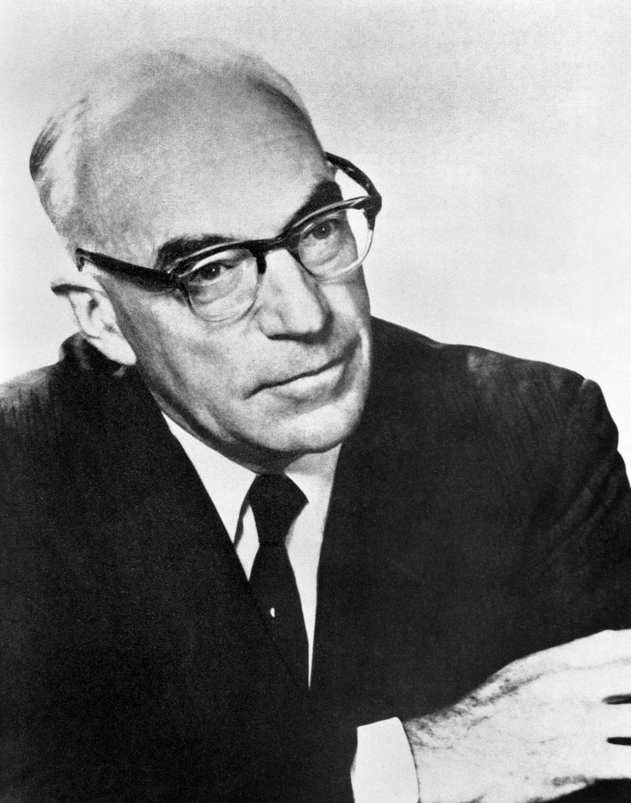
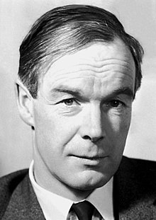


At the footsteps of greatness… An Equation(s) that fully explains the ionic mechanisms underlying the Action Potential A model that recapitulates a neuron firing!
John Eccles
Alan Hodgkin
Andrew Huxley

Slide 34
The MOST important question is your scientific hypothesis
What determines your use of a model is the question you are asking and at what level
Identify the level your question is at, then identify the ideal model
You cannot have it all – models at full scale are still not feasible
Hodgkin-Huxley model
is a model perfectly at its level – ions electrochemical gradients linked to membrane voltage
It models what was known about the two major ions, Na+ and K+
Show what models aim to do - integrate multiple factors to model how well it explains the mechanism being investigated
One factor included is the leak current (I_{L}), which is the current that leaks across the membrane due to leaky ion channels (something that naturally occurs in neurons)

Slide 35




Quick Summary – the full path to HH equations
Nernst Equation
describes the electrical potential of a concentration of individual ions
$$Vm=\frac{RT}{zF}ln\frac{ion concentration outside}{ion concentration inside}$$
GHK Equation
GHK is Nernst equation applied for multiple ions in a permeable membrane
Passive Membrane (i.e., resting membrane)
Coulombs Law
Capacitance can be derived as Coulomb’s Law of Capacitance
$$I_{C }=C_{m}\frac{dV_{m}}{dt}$$
Combine Coulombs Law + Ohms Law for resistors in series for all ions
Capacitance can be derived as Coulomb’s Law of Capacitance
$I=C_{m}\frac{dV_{m}}{dt}$+$g_{Na}(V_{m}$- $V_{Na}$) +$g_{K}(V_{m}$- $V_{K}$) +$g_{l}(V_{m}$- $V_{l}$)
Ohms Law for resistors in series
Finding for current across membrane for ions (remember why we can model as resistors in series)
$$I_{ion}=g_{ion}(V_{m}\text{− }V_{ion}\text{)}$$
Active Membrane (i.e., during an action potential)

Slide 36


Quick Summary – the full path to HH equations
Combine Coulomb’s Law + Ohm’s Law for resistors in series for all ions
Combine now capacitance calculation with Ohm’s law for each ion
$I=C_{m}\frac{dV_{m}}{dt}$+$g_{Na}(V_{m}$- $V_{Na}$) +$g_{K}(V_{m}$- $V_{K}$) +$g_{l}(V_{m}$- $V_{l}$)
Hodgkin-Huxley Equation combining Coulomb’s Law, Ohm’s Law and Gating variables
Adding in gating variables
$I=C_{m}\frac{dV_{m}}{dt}$+$g_{Na}m^{3}h(V_{m}$- $V_{Na}$) +$g_{K}n^{4}(V_{m}$- $V_{K}$) +$g_{l}(V_{m}$- $V_{l}$)
$$\frac{dn}{dt}=α_{n}\left(V_{m}\right)\left(1−n\right)−β_{n}\left(V_{m}\right)n$$
$$\frac{dm}{dt}=α_{m}\left(V_{m}\right)\left(1−m\right)−β_{m}\left(V_{m}\right)m$$
$$\frac{dh}{dt}=α_{h}\left(V_{m}\right)\left(1−h\right)−β_{h}\left(V_{m}\right)h$$

Slide 37


Hodgkin-Huxley in the context of compartmental models and passive membrane properties
We have been dealing with a small isolated portion of a neuronal membrane
We can extend our model to a compartment of models with repeated motifs of our isolated membrane
If we do so we need to include passive (native) properties
Cable theory is the area of computational neuroscience that models these properties
Here is an equation that we can integrate into our other equations to relate current (I) and restistance (R) to the rest of our equations (remember interdependence?)
$$I= \frac{a}{2R}\frac{∂^{2}V}{{∂x}^{2}}$$
Where a is the radius of the axon, R the cytoplasm resistance, x the position on the nerve
$∂$ indicates a partial derivative, which is a differential equations tool used to figure out how a quantity that depends on more than one factor changes when you adjust one of these factors

Slide 38


Multicompartmental models
These are large-scale models where every portion of the neuron is modeled with a compartment
These can be very exhaustive, and even the passive membrane properties changed in the axons versus the dendrites that are well identified experimentally

Slide 39
Let us take a moment to see what parts of the Hodgkin-Huxley model show us other computational areas in Neuroscience
We could model ion channel dynamics
We could model passive membrane properties
We could model how different ion channels impact action potentials
You know (and Wednesday especially) how Na and K channels are activated during an AP
You know how the electrochemical gradient of neuronal membranes is established
You know how ions’ electrochemical nature allows them to regulate the neuronal membrane and action potentials

Slide 40
The MOST important question is your scientific hypothesis
What determines your use of a model is the question you are asking and at what level
Identify the level your question is at, then identify the ideal model
You cannot have it all – models at full scale are still not feasible
What about modeling networks of neurons?

Slide 41

Approximating the dynamics of action potentials
A neurons threshold for an AP is about -55 to -50mv
AP are a very stereotyped event where the Vm is depolarizated-hyperpolarizated-refractory period
What if we… what if we just… modeled these dynamics? Wouldn’t that be computationally easier?
Not all but ~1-2million averaged waveforms from the PFC of a mouse

Slide 42

Approximating the dynamics of action potentials – Leaky-integrate and Fire neuron models
Leaky-integrate and Fire (LIF) neuron models are one of many varieties of neuronal models that approximate AP dynamics
LIF models state that an AP occurs when the Vm reaches a threshold
By avoiding biophysical modelling aspects, LIF models only need to model subthreshold dynamics of Vm
We aren’t going to throw away all the parts from Hodgkin-Huxley, the passive membrane properties (capacitance and resistance), because that is what makes our neuron models realistic

Slide 43



Leaky-integrate and Fire neuron models – derivation
We start just where we started for Hodgkin-Huxley
We start by modeling the entire current (I_{total}) of the system
$$I_{total}= I_{C}{+I}_{RL}+I_{ext}$$
We used this trick earlier, but how do we justify it?
Kirchoff’s current law – the total current ($I_{total}$) entering a system (node/junction) is equal to that flowing out of the system
The key to understanding Kirchoff’s current law is that the current of any electrical system has to go somewhere. If the current cannot go to $I_{1}$and $I_{4}$then the current will not enter the node at $I_{2}$and $I_{3}$
Therefore, the sum of the current in the node $I_{total}$($I_{k}$) is always balanced (input and output current sum together = 0)
Note that the $I_{c}$ is current of capacitance, $I_{RL}$ current of leak resistance (previously this was $I_{l}$ - as we are referring to the leak current across the membrane) $I_{Ext}$ is current applied externally (think injected neuron with current or inputting synapses to a neuron)
This is an RC circuit which is a resistor-capacitance circuit
Kirchoff’s current law
$$I_{2}+I_{3}= I_{1}{+I}_{4}$$
$\sum_{k=1}^{n}{I_{k}}$ = 0

Slide 44


Leaky-integrate and Fire neuron models – derivation
Now we have modeled everything for the passive membrane properties
The AP dynamics of the model will be explicitly stated later; therefore we are done:
$I_{total}= I_{C}{+I}_{RL}+I_{ext}$
Let's be good mathematicians and substitute in equations we know for the above variables
$I_{C}=C_{m}\frac{dV_{m}}{dt}$
$I_{RL}=\frac{V_{m}−V_{rest}}{R_{m}}$
$C_{m}$ is the membrane capacitance
$V_{m}$ is the membrane potential at any given time (previously meant resting membrane potential when we weren’t talking about action potentials so $V_{m}$ = $V_{rest}$ )
Now we know, for instance during an action potential $V_{m}$ ≠$V_{rest}$ so we denote resting membrane potential as $V_{rest}$

Slide 45

Leaky-integrate and Fire neuron models – derivation
Let’s substitute in new values for $I_{C}$ and $I_{RL}$
$I_{total}=C_{m}\frac{dV_{m}}{dt}+\frac{V_{m}−V_{rest}}{R_{m}}+I_{ext}$
Moving $\frac{dV_{m}}{dt}$ to the left side and recognize that according to Kirchoff’s law that current into a neuron will equal current out of a neuron, so $I_{total}−I_{ext}=$ 0
Now we have:
$\frac{dV_{m}}{dt}$ = $\frac{{−(V}_{m}−V_{rest)}}{R_{m}C_{m}}+\frac{I_{ext}}{C_{m}}$

Slide 46

Leaky-integrate and Fire neuron models – derivation
Often the following value is replaced in LIF equations because it is commonly found experimentally so is easier to simply input:
The Tau membrane constant:
$τ_{m}= R_{m}$ $C_{m}$
Replace our update equation with $τ_{m}$
$\frac{dV_{m}}{dt}$ = $\frac{{−(V}_{m}−V_{rest)}}{τ_{m}}+\frac{I_{ext}}{C_{m}}$

Slide 47

Leaky-integrate and Fire neuron models – implementation
Let us think through our equation:
$\frac{dV_{m}}{dt}$ = $\frac{{−(V}_{m}−V_{rest)}}{τ_{m}}+\frac{I_{ext}}{C_{m}}$
Now we implement these equations to produce an AP:
Voltage threshold ($V_{thr}$) the voltage where an action potential occurs
The amount of $I_{ext}$ needed to elicit an AP is $I_{threshold }$- the amount of current needed to elicit an AP
$$I_{thr}=\frac{V_{thr}}{R_{m}}$$

Slide 48



Leaky-integrate and Fire neuron models – implementation
The following set function implements firing:
$firing \left(I\right)=\left\{\begin{aligned}0 \\ {\left[t_{refr}−R_{m}C_{m}\log\left(1−\frac{V_{thr}}{{IR}_{m}}\right)\right]}^{−1}\end{aligned}\right.$ ,
While seemingly complicated, the above states if the $I≤I_{thr}$ then the LIF neuron does not fire (firing (I) = 0)
If the $I>I_{thr}$ then the LIF neuron reaches an AP by implementing:
$${\left[t_{refr}−R_{m}C_{m}\log\left(1−\frac{V_{thr}}{{IR}_{m}}\right)\right]}^{−1}$$
$$I≤I_{thr}$$
$$I>I_{thr}$$

Slide 49

Why does this AP not look like an AP in LIF
Because we are simply mimicking the nature of a neurons AP – that when inputting current increases Vm to above its AP Vthr then we have an AP
When you see the value reset, an AP has just occurred with LIF
…
V_rest = -75*mV # Resting potential
V_threshold = -50*mV # Threshold potential
R_m = 100*Mohm # Membrane resistance
tau_m = 10*ms # Membrane time constant
I = .5*nA # Input current

Slide 50



What can these models do:
Large networks of LIF neurons or Single-Ohmic HH models to look at network events in the brain such as oscillations
Single-Ohmic Hodgkin-Huxley model (PING model)
Coupled LIF model
Ostojic Nature Neuroscience 2014
Wang and Buzsaki The Journal of Neuroscience 1996

Slide 51

Teaching References
Ermentrout and Terman (2010). Mathematical Foundations of Neuroscience. Springer New York Dodrecht Heidelberg London.
Dayan and Abbott (2001). Theoretical Neuroscience: Computational and Mathematical Modeling of Neural Systems. MIT Press.
Mallot (2013). Computational Neuroscience: A First Course. Springer New York Dodrecht Heidelberg London.
Molleman (2003). Patch Clamping: An Introductory Guide to Patch Clamp Electrophysiology. John Wiley & Sons Ltd.
Funding
F32MH134673

